Slide 1

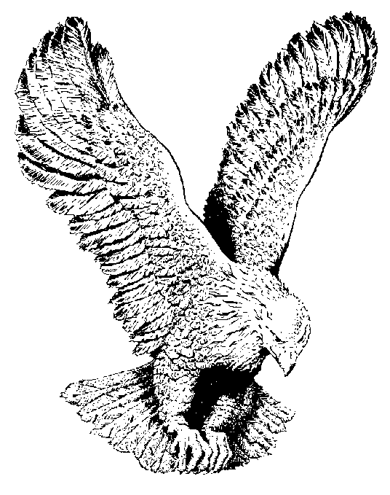
KABIYESI
Ka-bi-ye-si
Oba Gbogbo Aiye
Baba Ese Gan

